Slide 1
K-nearest neighbour

Slide 2
INTRODUCTION
’Birds of a feather flock together.’
Things that are alike are likely to have properties that are alike
→
We can use this principle to classify data by placing it in the category with the most similar, or “nearest” neighbours

Slide 3
INTRODUCTION
kNN classifiers are defined by their characteristic of classifying unlabelled instances by assigning them the class of the most similar labelled instances.
Simple method, but nevertheless powerful

Slide 4
SUCCESSFUL APPLICATION OF KNN
Computer vision applications
  OCR
  face recognition (images/video)
Netflix Challenge (does a person enjoy a recommended movie)
Identifying patterns in genetic data (detecting specific proteins/diseases)
7

Slide 5
When to use kNN Algorithm?
Well-suited for classification tasks where relationships among the attributes and target classes are:
numerous
complex
difficult to understand
But, instances of a class type are quite homogeneous
In other words: If a concept is difficult to define, but you know it when you see it.

Slide 6
When NOT to use kNN Algorithm?
The kNN algorithm is not good to identify boundaries if the problem does not clearly differentiate between classes

Slide 7
Strength and Weaknesses
Weaknesses:
No model: Limits getting insights about feature relationships
Requires lots of memory
Nominal features/missing data requires extra processing
Strengths:
Simple and effective
No assumptions about underlying data distribution
Fast training phase

Slide 8
THE KNN ALGORITHM
Algorithm kNN (D,d,k)
Compute the distance betweeen d and every example in D;
Choose the k examples in D that are nearest to d, denote the set by P(⊆ D);
Assign d the class that is the most frequent class (or the majority class) in P

Slide 9
kNN: Example - Food Types
Let's say we described certain types of food via how we rated their taste and sweetness;
Then we would be able to create a plot like this:

Slide 10
KNN: EXAMPLE - FOOD TYPES
Celery
Carrot
Lettuce
Cucumber
Apple
Crunchiness
Pear
Green bean
Grape
Nuts
Bacon
Orange
Shrimp
Fish
Cheese
Banana
Sweetness

Slide 11
kNN: Example - Food Types
Did you notice the pattern?
Similar types of food tend to be grouped closely together
The feature space is two-dimensional
Two features: sweetness and crunchiness
We can plot two-dimensional data on a scatterplot
X: sweetness
Y: crunchiness
Indeed we may be able to look at some extra dimension that lists it’s food type…

Slide 12
KNN: EXAMPLE - FOOD TYPES
Vegetables
Celery
Carrot
Lettuce
Cucumber
Apple
Crunchiness
Pear
Green bean
Fruits
Grape
Nuts
Bacon
Orange
Shrimp
Fish
Cheese
Proteins
Banana
Sweetness

Slide 13
KNN: EXAMPLE - FOOD TYPES (NEW INSTANCE)
Vegetables
Celery
Carrot
Lettuce
Cucumber
Apple
Green bean
Pear
Crunchiness
Fruits
Grape
Nuts
Tomato
?
Bacon
Orange
Shrimp
Fish
Proteins
Cheese
Banana
Sweetness

Slide 14

kNN: Distance
Where does the Tomato fit?
→ We need a distance / similarity score
The kNN algorithm treats the features as coordinates in a multi-dimensional feature space (not just 2D).
2D space is easy to plot → multi-D is not!

Slide 15
kNN: Euclidean Distance
There are many measures of distance, but the most basic is Euclidean distance
Distance were you to use a ruler to connect two points (dotted lines)
kNN algorithm traditionally uses Euclidean distance

Slide 16
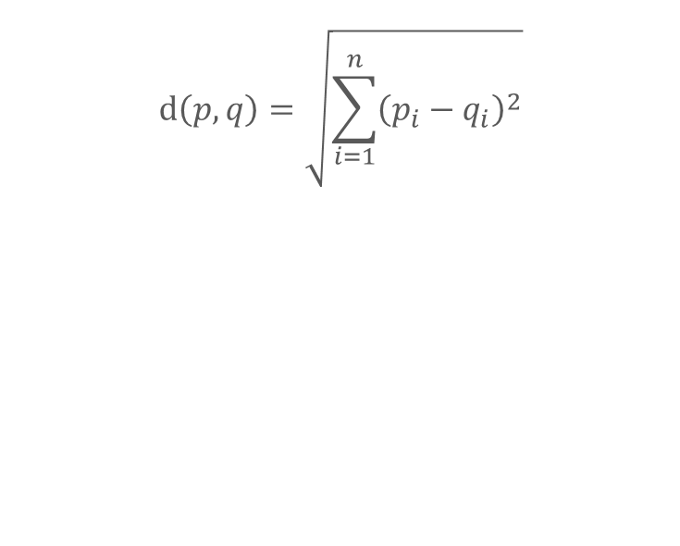
KNN: EUCLIDEAN DISTANCE
Euclidean distance is specified by the following formula:
$$ⅆ\left(p,q\right)=\sqrt{\sum_{i=1}^{n}{{\left(p_{i}−q_{i}\right)}^{2}}}$$
p and q are the examples to be compared
Each has n attributes.
p_{i} is the value of the i_{t}h attribute of instance p
q_{i} is the value of the i_{t}h attribute of instance q
We comparing the values of each attribute.

Slide 17
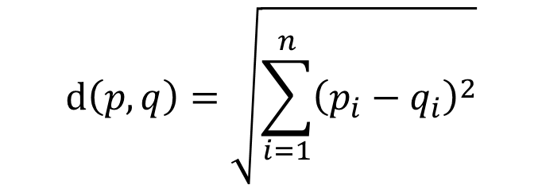
KNN: EUCLIDEAN DISTANCE
Euclidean distance is specified by the following formula:
$$ⅆ\left(p,q\right)=\sqrt{\sum_{i=1}^{n}{{\left(p_{i}−q_{i}\right)}^{2}}}$$
Assume tomato is [sweetness = 6, crunchiness = 4] and
green bean [sweetness = 3, crunchiness = 7]

Slide 18
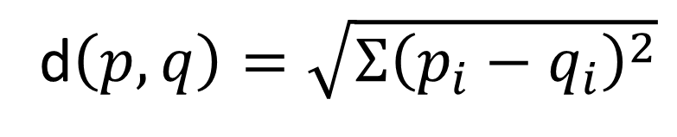

KNN: EXAMPLE - FOOD TYPES (EUCLIDEAN DISTANCE)
Euclidean distance is specified by the following formula:
d$\left(p,q\right)=\sqrt{Σ{\left(p_{i}−q_{i}\right)}^{2}}$
Assume tomato is [sweetness = 6, crunchiness = 4] and
green bean [sweetness = 3, crunchiness = 7]
What is the Euclidean distance between those?
Is the distance symmetrical?
$$\sqrt{{\left(6−3\right)}^{2}+{\left(4−7\right)}^{2}}=4.2$$

Slide 19




KNN: EXAMPLE - FOOD TYPES (EUCLIDEAN DISTANCE)
Lets assume these values for other instances:
Ingredient | S | C | Food type | Distance to Tomato
Grape | 8 | 5 | Fruit
Green bean | 3 | 7 | Vegetable
Nuts | 3 | 6 | Protein
orange | 7 | 3 | fruit
$$\sqrt{{\left(6−8\right)}^{2}+{\left(4−5\right)}^{2}}=2.2$$
$$\sqrt{{\left(6−3\right)}^{2}+{\left(4−7\right)}^{2}}=4.2$$
$$\sqrt{{\left(6−3\right)}^{2}+{\left(4−6\right)}^{2}}=3.6$$
$${\sqrt{{\left(6−7\right)}^{2}+\left(4−3\right)}}^{2}=1.4$$
S(weetness) and C(runchiness)
To classify the tomato as a vegetable, protein, or fruit, we’ll begin by assigning the tomato, the food type of its single nearest neighbour.
This is a 1NN classification because k = 1.
The orange is the nearest neighbour to the tomato (with distance of 1.4).

Slide 20
KNN: DECISION BOUNDARY
The BIG question: What should k be?

Slide 21
Selecting k
As orange is a fruit, the kNN algorithm would classify tomato as a fruit. k = 1
If we use k = 3 instead, a vote among the three nearest neighbours is needed:
orange, grape, and nuts.
The predominant class here is fruit (2 of 3 votes), the tomato again is classified as a fruit.
It’s not immediately obvious from this example, but we need to think about what our k should be.
There IS NOT a single definitive answer as to what k should be!

Slide 22
Selecting k
Deciding how many neighbours to use for kNN defines how well the model will generalize future instances.
Bias-variance trade-off:
Balance: over-fitting ↔ under-fitting the training data

Slide 23
Selecting k: Very Large
Very large k (equal instance training set)
every training instance is represented in the final vote
the most common training class always has a majority vote
this predicts the majority class, regardless of which neighbours are nearest

Slide 24
Selecting k: Large
Large k
Reduces the impact or variance caused by noisy data, but can bias the learner such that it runs the risk of ignoring small, but important patterns.

Slide 25
Selecting k: Very Small
k = 1:
allows noisy data or outliers to strongly influence the classification
e.g. mislabelled instances: Instances nearest the incorrectly labelled neighbours will be assigned to the incorrect class

Slide 26
SELECTING K
Best k value is somewhere between these two extremes
We are going to introduce a plot where we have draw a hypothetical ‘decision boundary’ by a dotted line.
It’s useful to think of all classification approaches, and their settings, this way.

Slide 27
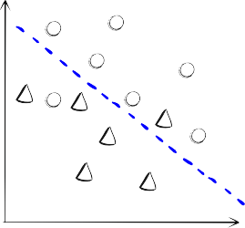
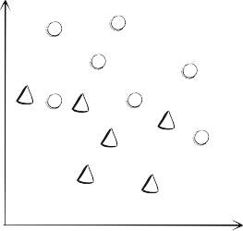
KNN: DECISION BOUNDARY
So, how is the decision boundary affected by larger and smaller values for k?
Larger k
Smaller k

Slide 28
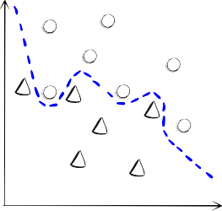
KNN: DECISION BOUNDARY
Larger k
Smaller k
Smaller values allow more complex decision boundaries that more carefully fit the training data.
BUT we do not know whether the straight or curved boundary better represents the true underlying concept to be learned.

Slide 29
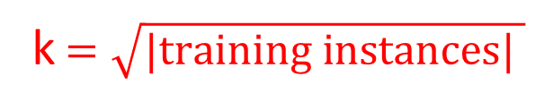
PRAGMATICALLY SELECTING K
In practice, choosing k depends on:
the difficulty of the concept to be learned
the number of instances in the training data
Typically: 3 ≤ k ≤ 10
Common practice:
→ Does not always result in the best k
k$=\sqrt{{|training instances|}^{ }}$

Slide 30
Data Preparation
Distance function can be affected by the potential ranges of the dimensions
What could happen if one dimension has values between 1 and 10 and another has values between 0 and 1000?
So what can we do?

Slide 31
Data Preparation
So what can we do?
Transform the data (as with z-scores etc.).
Traditional method for rescaling kNN features is min-max normalization.
Transform a feature so that all values are [0, 1]

Slide 32
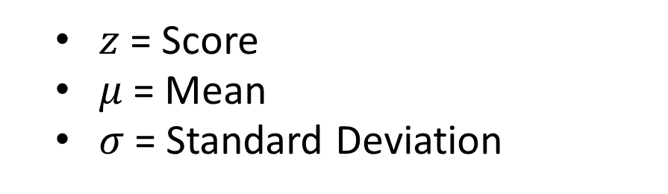
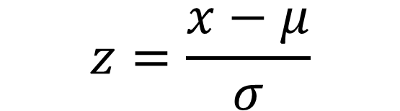
DATA PREPARATION
$$z=\frac{x−μ}{σ}$$
$z$= Score
$μ$= Mean
$σ$= Standard Deviation

Slide 33
Learning Class
Why is the kNN algorithm lazy?
  Technically speaking, no abstraction occurs.
Based on the definition of learning, a lazy learner is not learning anything
Instead, it stores the training data verbatim
As mentioned earlier, it is a type of instance-based learning; which means it produces a class label/predication based on the similarity of the query to its nearest neighbor(s) in the training set

Slide 34




KNN: EXAMPLE - CREDIT CHECK
Although kNN classifiers may be considered lazy, they are still quite powerful.
Will our client David respond to our credit card marketing offer or not?
Client | Age | Income(k) | Cards | Response | Distance to David
David | 37 | 50 | 2 | ? | 0
John | 35 | 35 | 3 | Yes
Rachael | 22 | 50 | 2 | No
Ruth | 63 | 200 | 1 | No
Bill | 59 | 170 | 1 | No
Norah | 25 | 40 | 4 | Yes
$$\sqrt{{\text{(}\text{3}\text{5} \text{−} \text{37}\text{)}\text{2} \text{+} \text{(}\text{35} \text{−} \text{50}\text{)}\text{2} \text{+} \text{(}\text{3} \text{−} \text{2}\text{)}\text{2} \text{=} \text{15}\text{.}\text{16}}^{ }}$$
$$\sqrt{{\text{(}\text{2}\text{2} \text{−} \text{37}\text{)}\text{2} \text{+} \text{(}\text{5}\text{0} \text{−} \text{50}\text{)}\text{2} \text{+} \text{(}\text{2} \text{−} \text{2}\text{)}\text{2} \text{=} \text{15}}^{ }}$$
$$\sqrt{{\text{(}\text{63} \text{−} \text{37}\text{)}\text{2} \text{+} \text{(}\text{20}\text{0} \text{−} \text{50}\text{)}\text{2} \text{+} \text{(}\text{1} \text{−} \text{2}\text{)}\text{2} \text{=} \text{15}\text{2.23}}^{ }}$$
$$\sqrt{{\text{(}\text{5}\text{9} \text{−} \text{37}\text{)}\text{2} \text{+} \text{(}\text{170} \text{−} \text{50}\text{)}\text{2} \text{+} \text{(}\text{1} \text{−} \text{2}\text{)}\text{2} \text{=} \text{1}\text{22}}^{ }}$$
$$\sqrt{{\text{(}\text{25} \text{−} \text{37}\text{)}\text{2} \text{+} \text{(}\text{40} \text{−} \text{50}\text{)}\text{2} \text{+} \text{(}\text{4} \text{−} \text{2}\text{)}\text{2} \text{=} \text{15}\text{.}\text{74}}^{ }}$$

Slide 35
Exercise
Scenario : Classifying Emails
You are using KNN to classify emails as spam or not spam.
Questions:
How would you choose the value of k for this problem? Explain your reasoning.
How does increasing or decreasing k affect the model’s bias and variance?
How would you handle imbalanced classes (e.g., far fewer spam emails than non-spam emails) when using KNN?

Slide 36
kNN: Example - Credit Check
Using similarity for predictive modelling is beautifully simple.
Given a new instance (whose target attribute we want to predict) scan through all instances and choose several that are the most similar.
Then predict new instance’s target attribute, based on Nearest Neighbours’ (known) target attributes.
The last step so far has been defined as simple voting.

Slide 37
kNN
So this is great, but is it meaningful!?
What if we changed one data mining task with another?
Once we retrieved nearest neighbours, we can use them for any potential predictive mining task by combining them in different ways.
e.g. we can build a regression model just using the nearest neighbours.

Slide 38
kNN
Advantages
The algorithm is simple and easy to implement.
There’s no need to tune several parameters, or make additional assumptions.
The algorithm is versatile. It can be used for classification and regression.
Disadvantages
The algorithm gets significantly slower as the number of examples and/or predictors/independent variables increase.

